Slide 1
LinkedIn Team
Nick Manring nmanring@gmail.com
Sandra Perdomo sperdomo456@gmail.com
Emma Quinn emjquinn7@gmail.com
Andrea Cantú canturo_andr@bentley.edu
Pratik Gami pratikgami@gmail.com

Slide 2
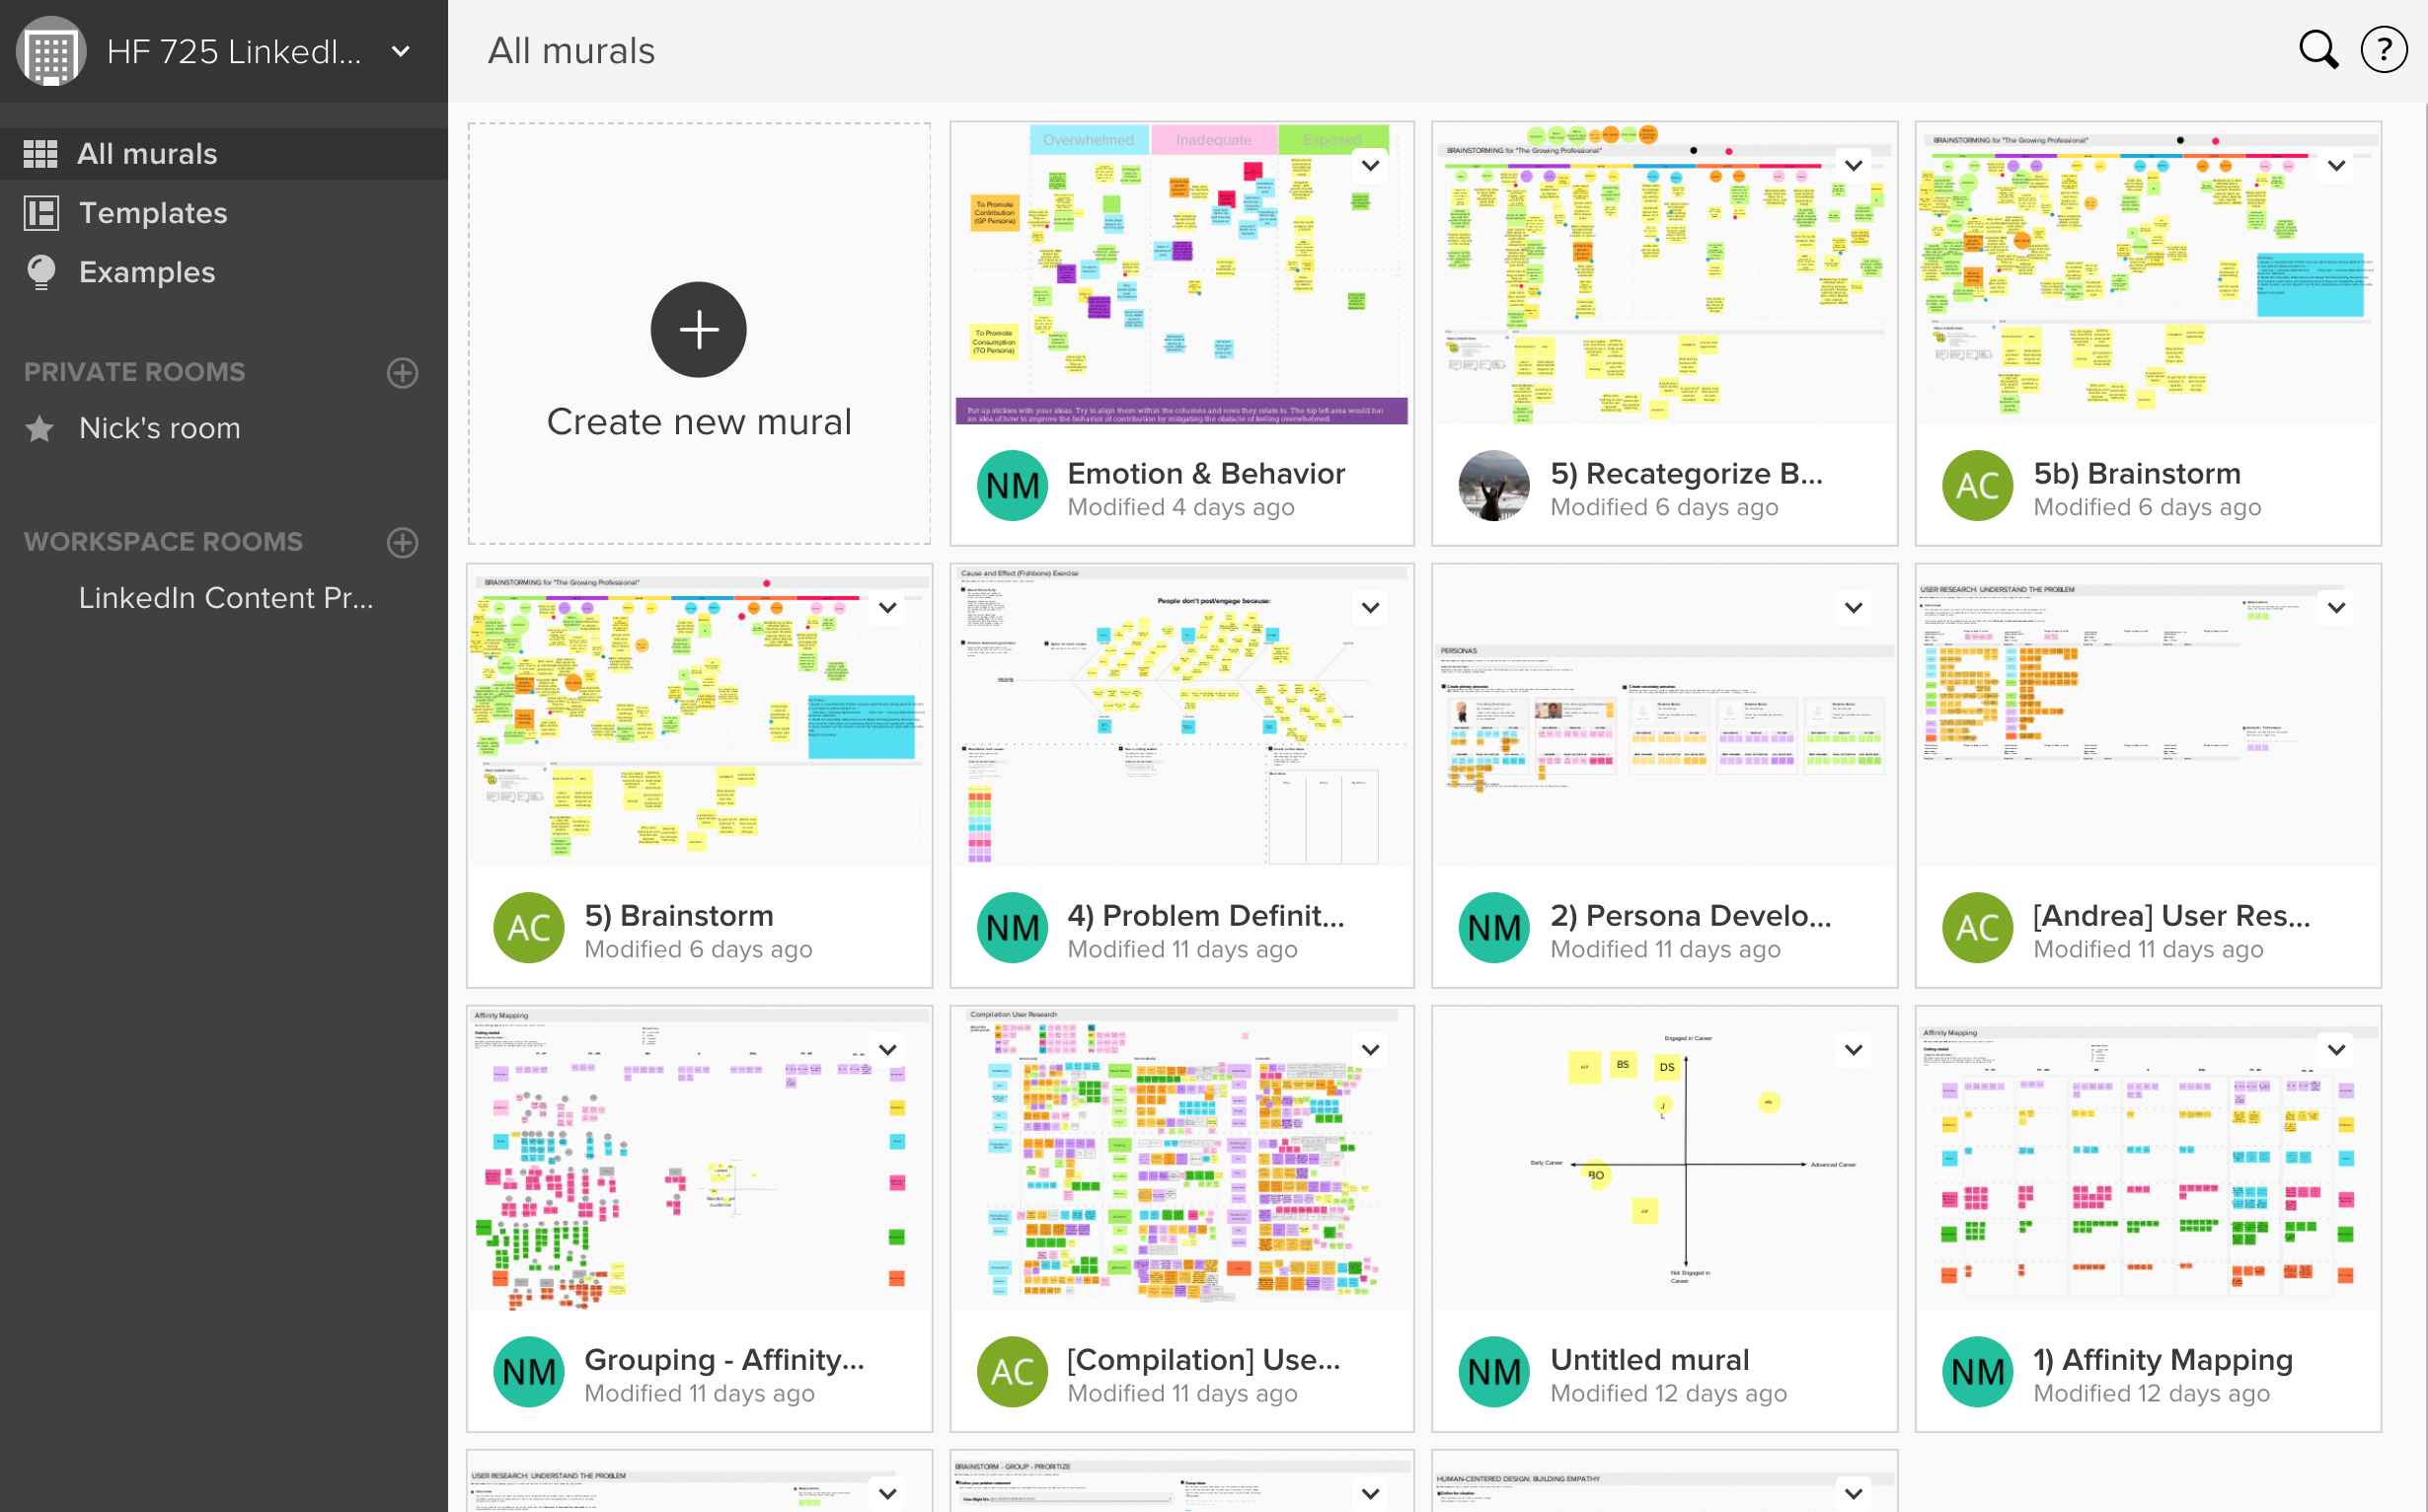
High Level Process
Establish Expectations and Discuss Our Strengths / Obstacles with Team
Think Broadly About The Challenge
Narrow Our Study Scope & Design Study / Protocol
Perform Exploratory / Discovery Research
Share Data and Perform Affinity Mapping
Develop Personas Based on Themes in Motivations, Behavior
Brainstorm Relationships to Emotions: Fear Specifically
Share Research with Stakeholder and Gain Feedback
Go Broad to Reframe Challenge
Narrow in to Define the Real Problems
Brainstorm Solutions with Emotions and Mental Model in Focus
Produce and Present Ideas and Exemplary Solutions to Client
Reflect on Project Process and Congratulate the Team!

Slide 3
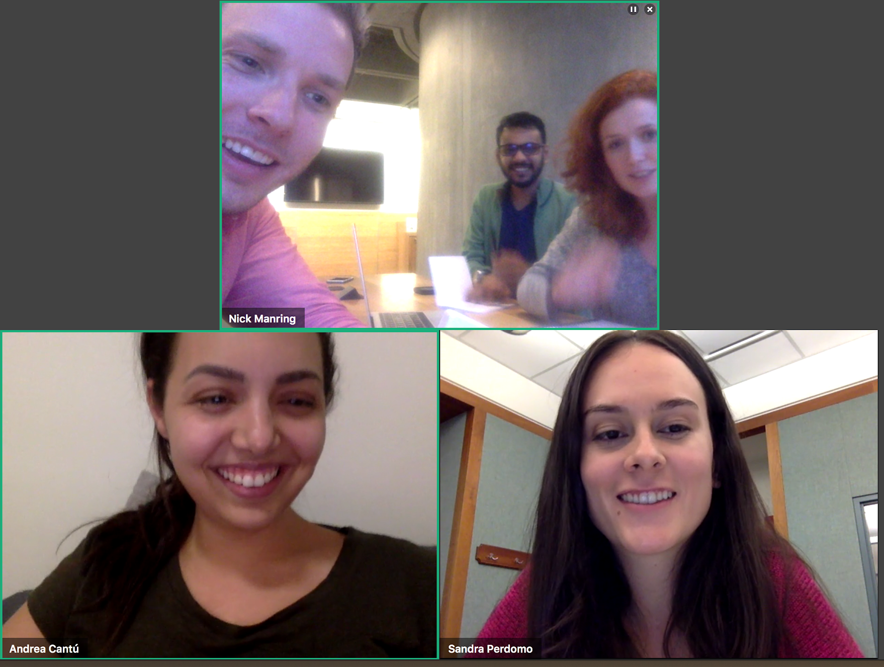
Establish Expectations and Strengths / Obstacles
Introspective conversation to get to know one another, understand personality and communication types
Establish meeting times and work effort expectations
Discussed collaboration tools / platforms

Slide 4
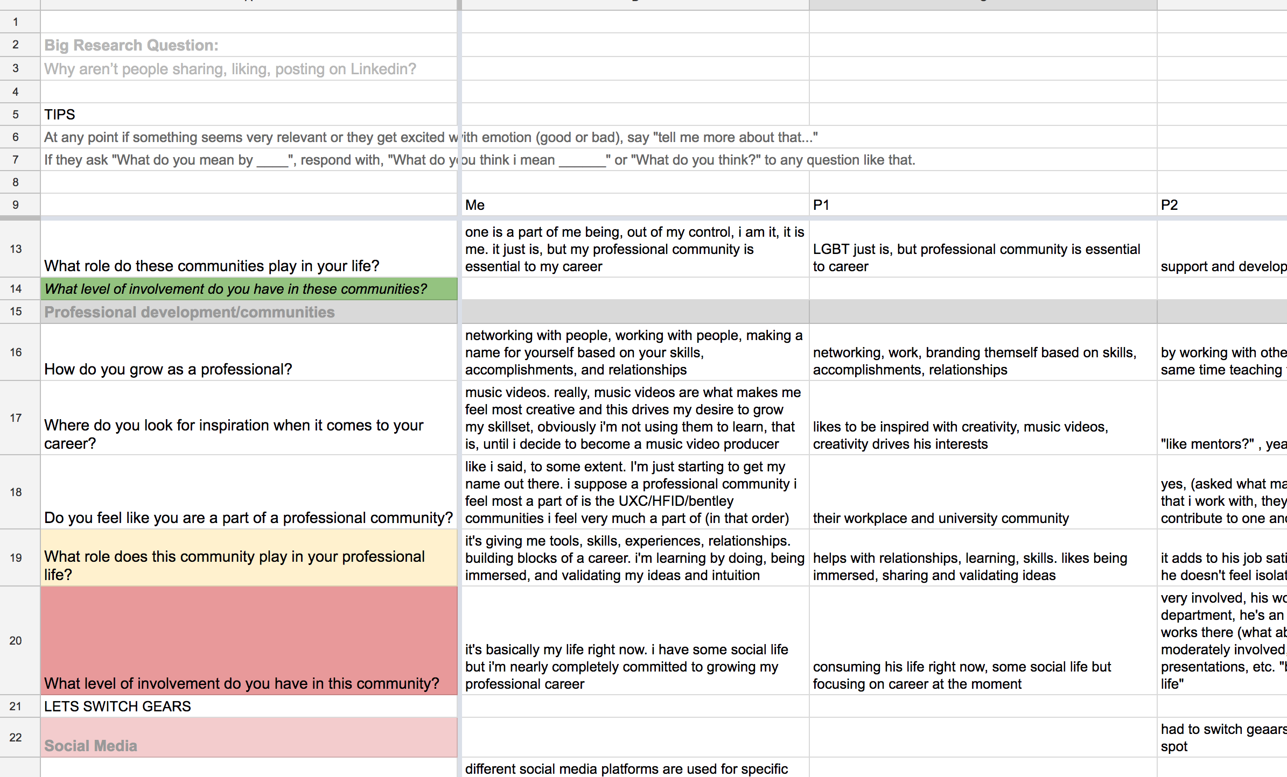
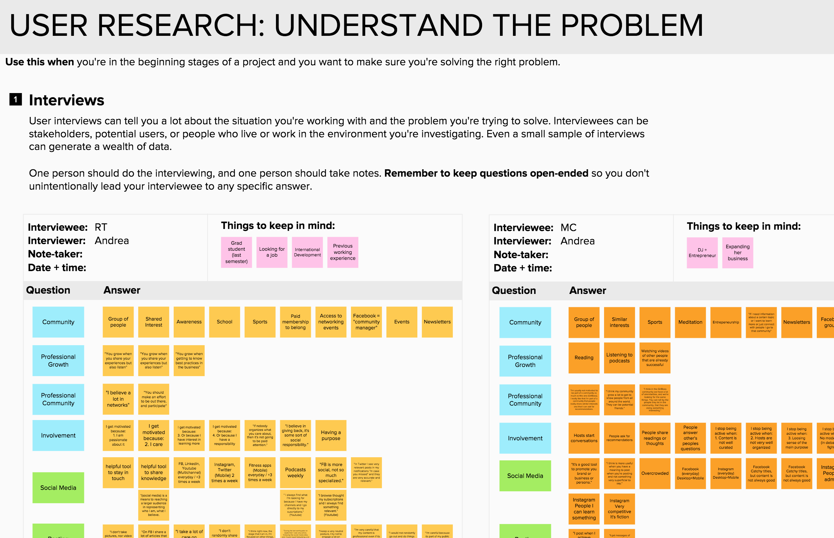
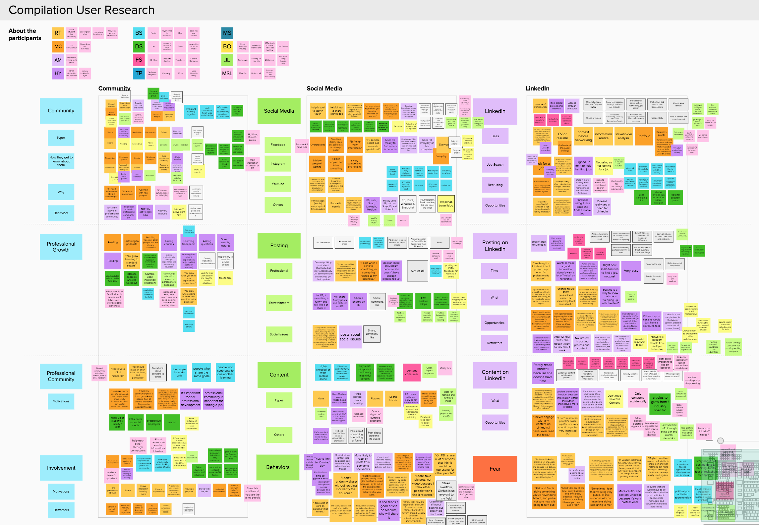
Study Design & Research
N = 12-15
Formal & Informal Interviews
45-60 min (formal)
Opened new LinkedIn accounts to explore the entire journey
Collected data individually and then put our notes into stickies
We then combined our research onto a large board to identify themes

Slide 5
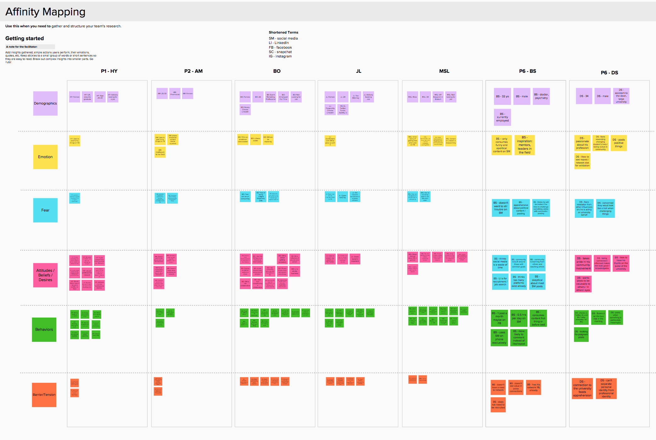
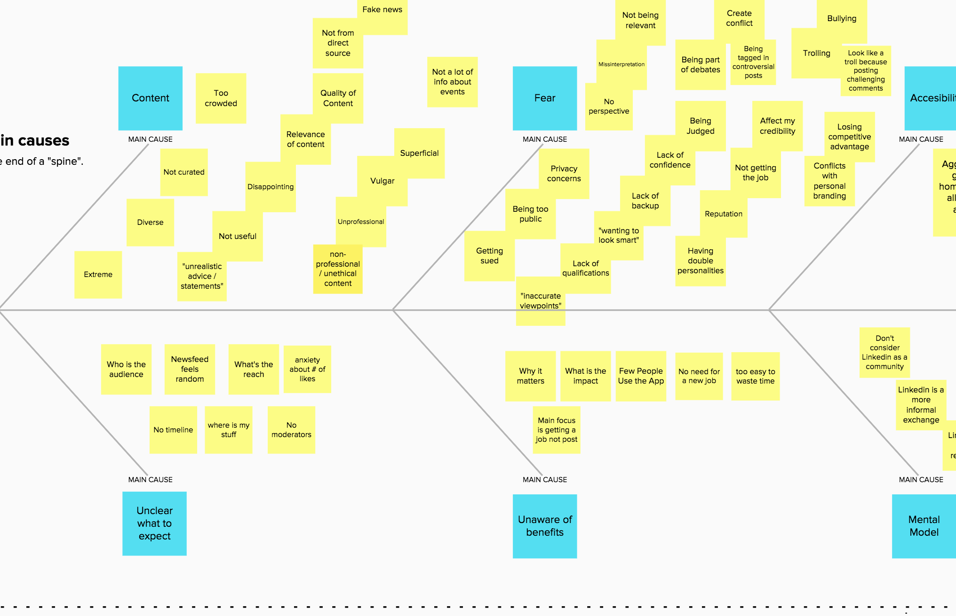
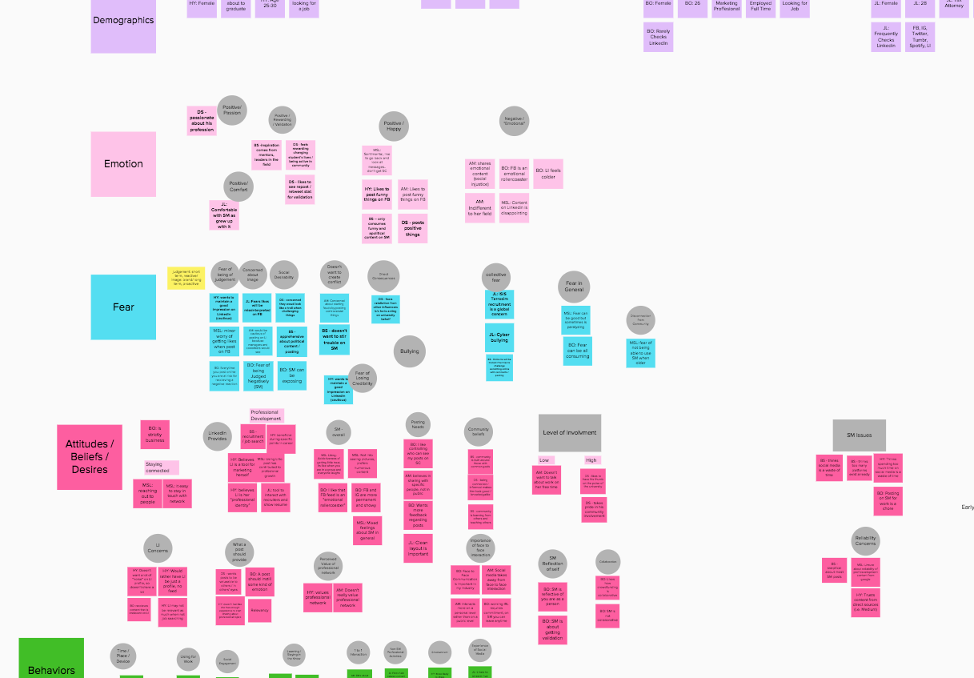
Affinity Mapping & Problem Definition
Narrowed down themes with affinity mapping
Defined problem further using fishbone diagrams

Slide 6
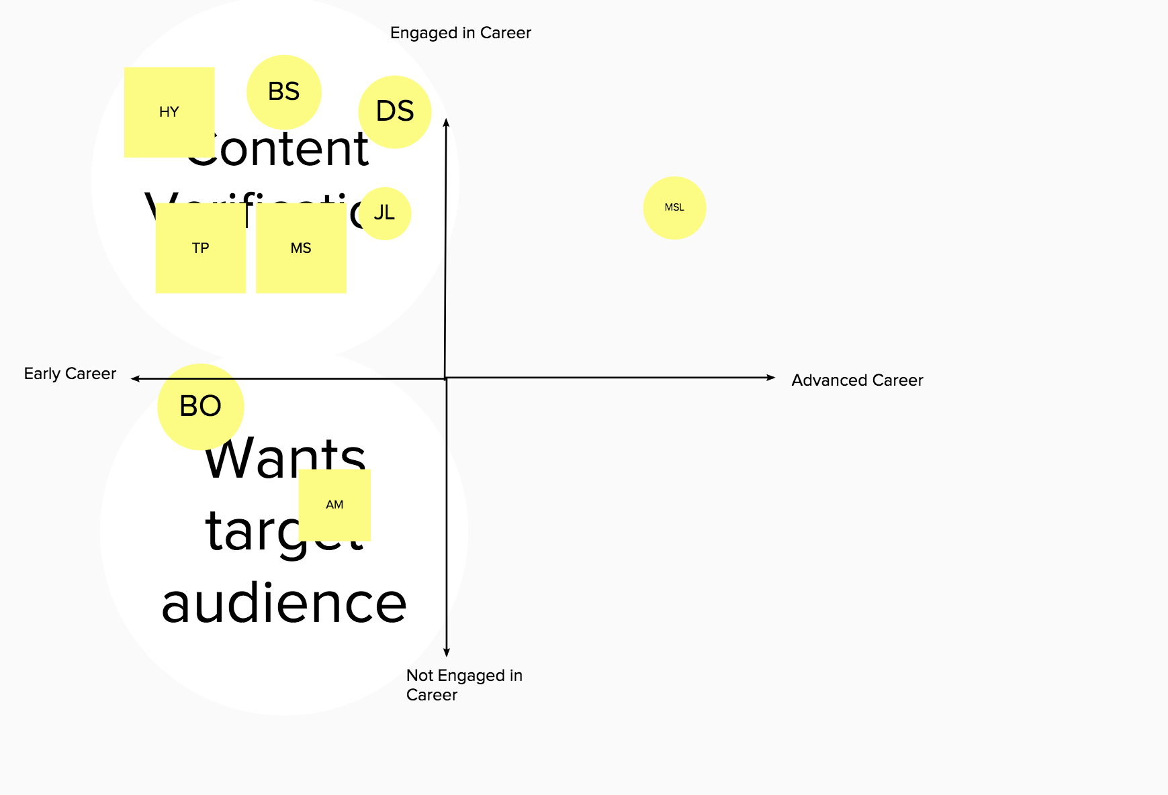
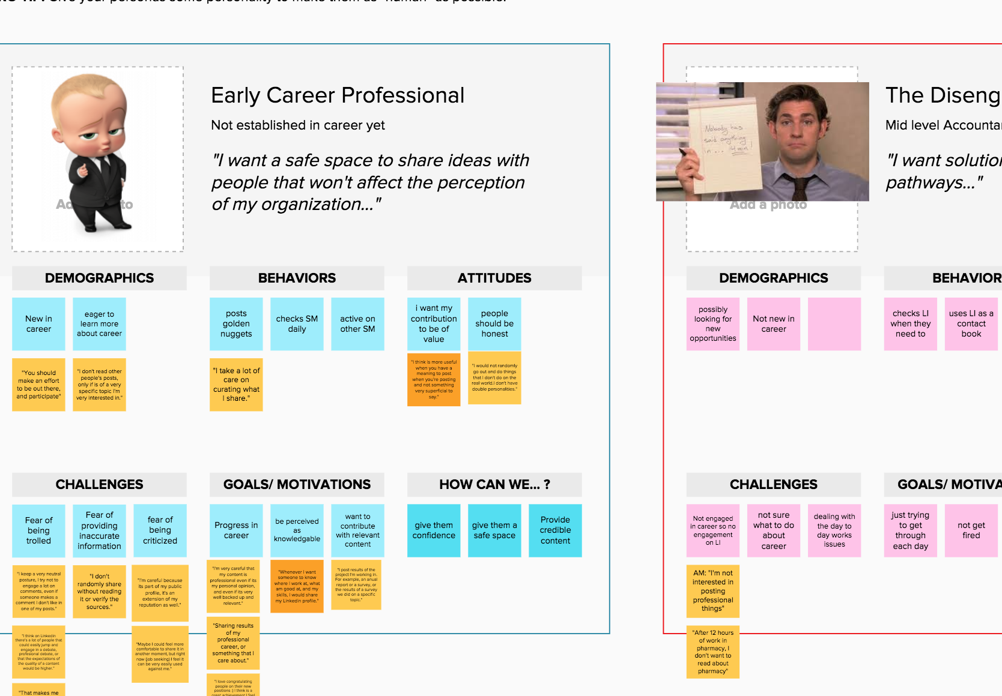
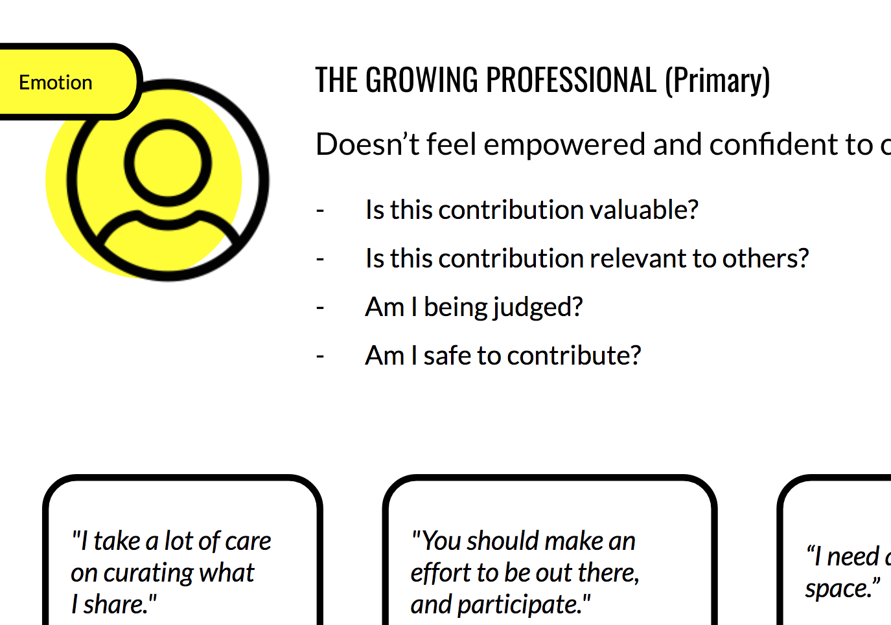
Develop Persona & Involve Stakeholder in Process
Understood what groups of emotions and behaviors set users apart
Presented persona and research findings, including the stakeholder in the process
Honed in on a primary persona, while still considering effects on secondary, as we brainstorm solutions

Slide 7
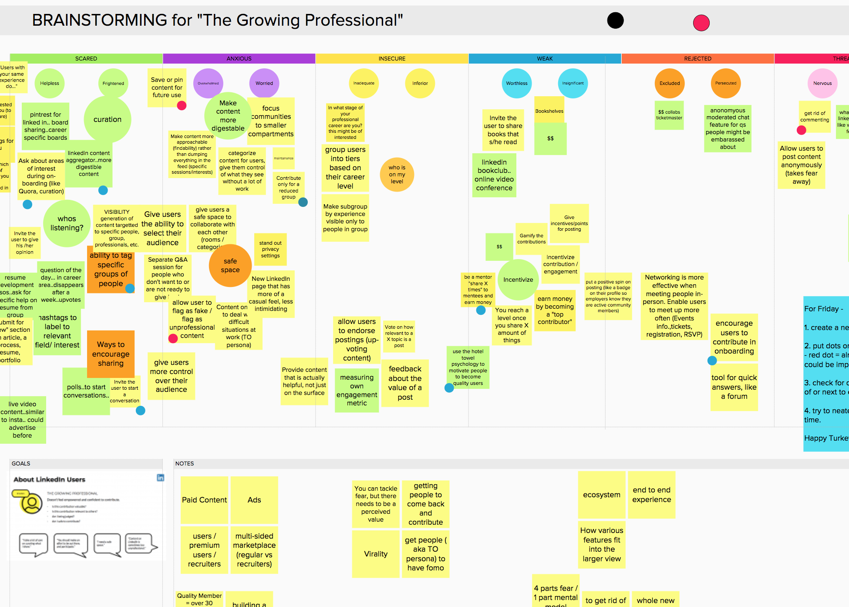
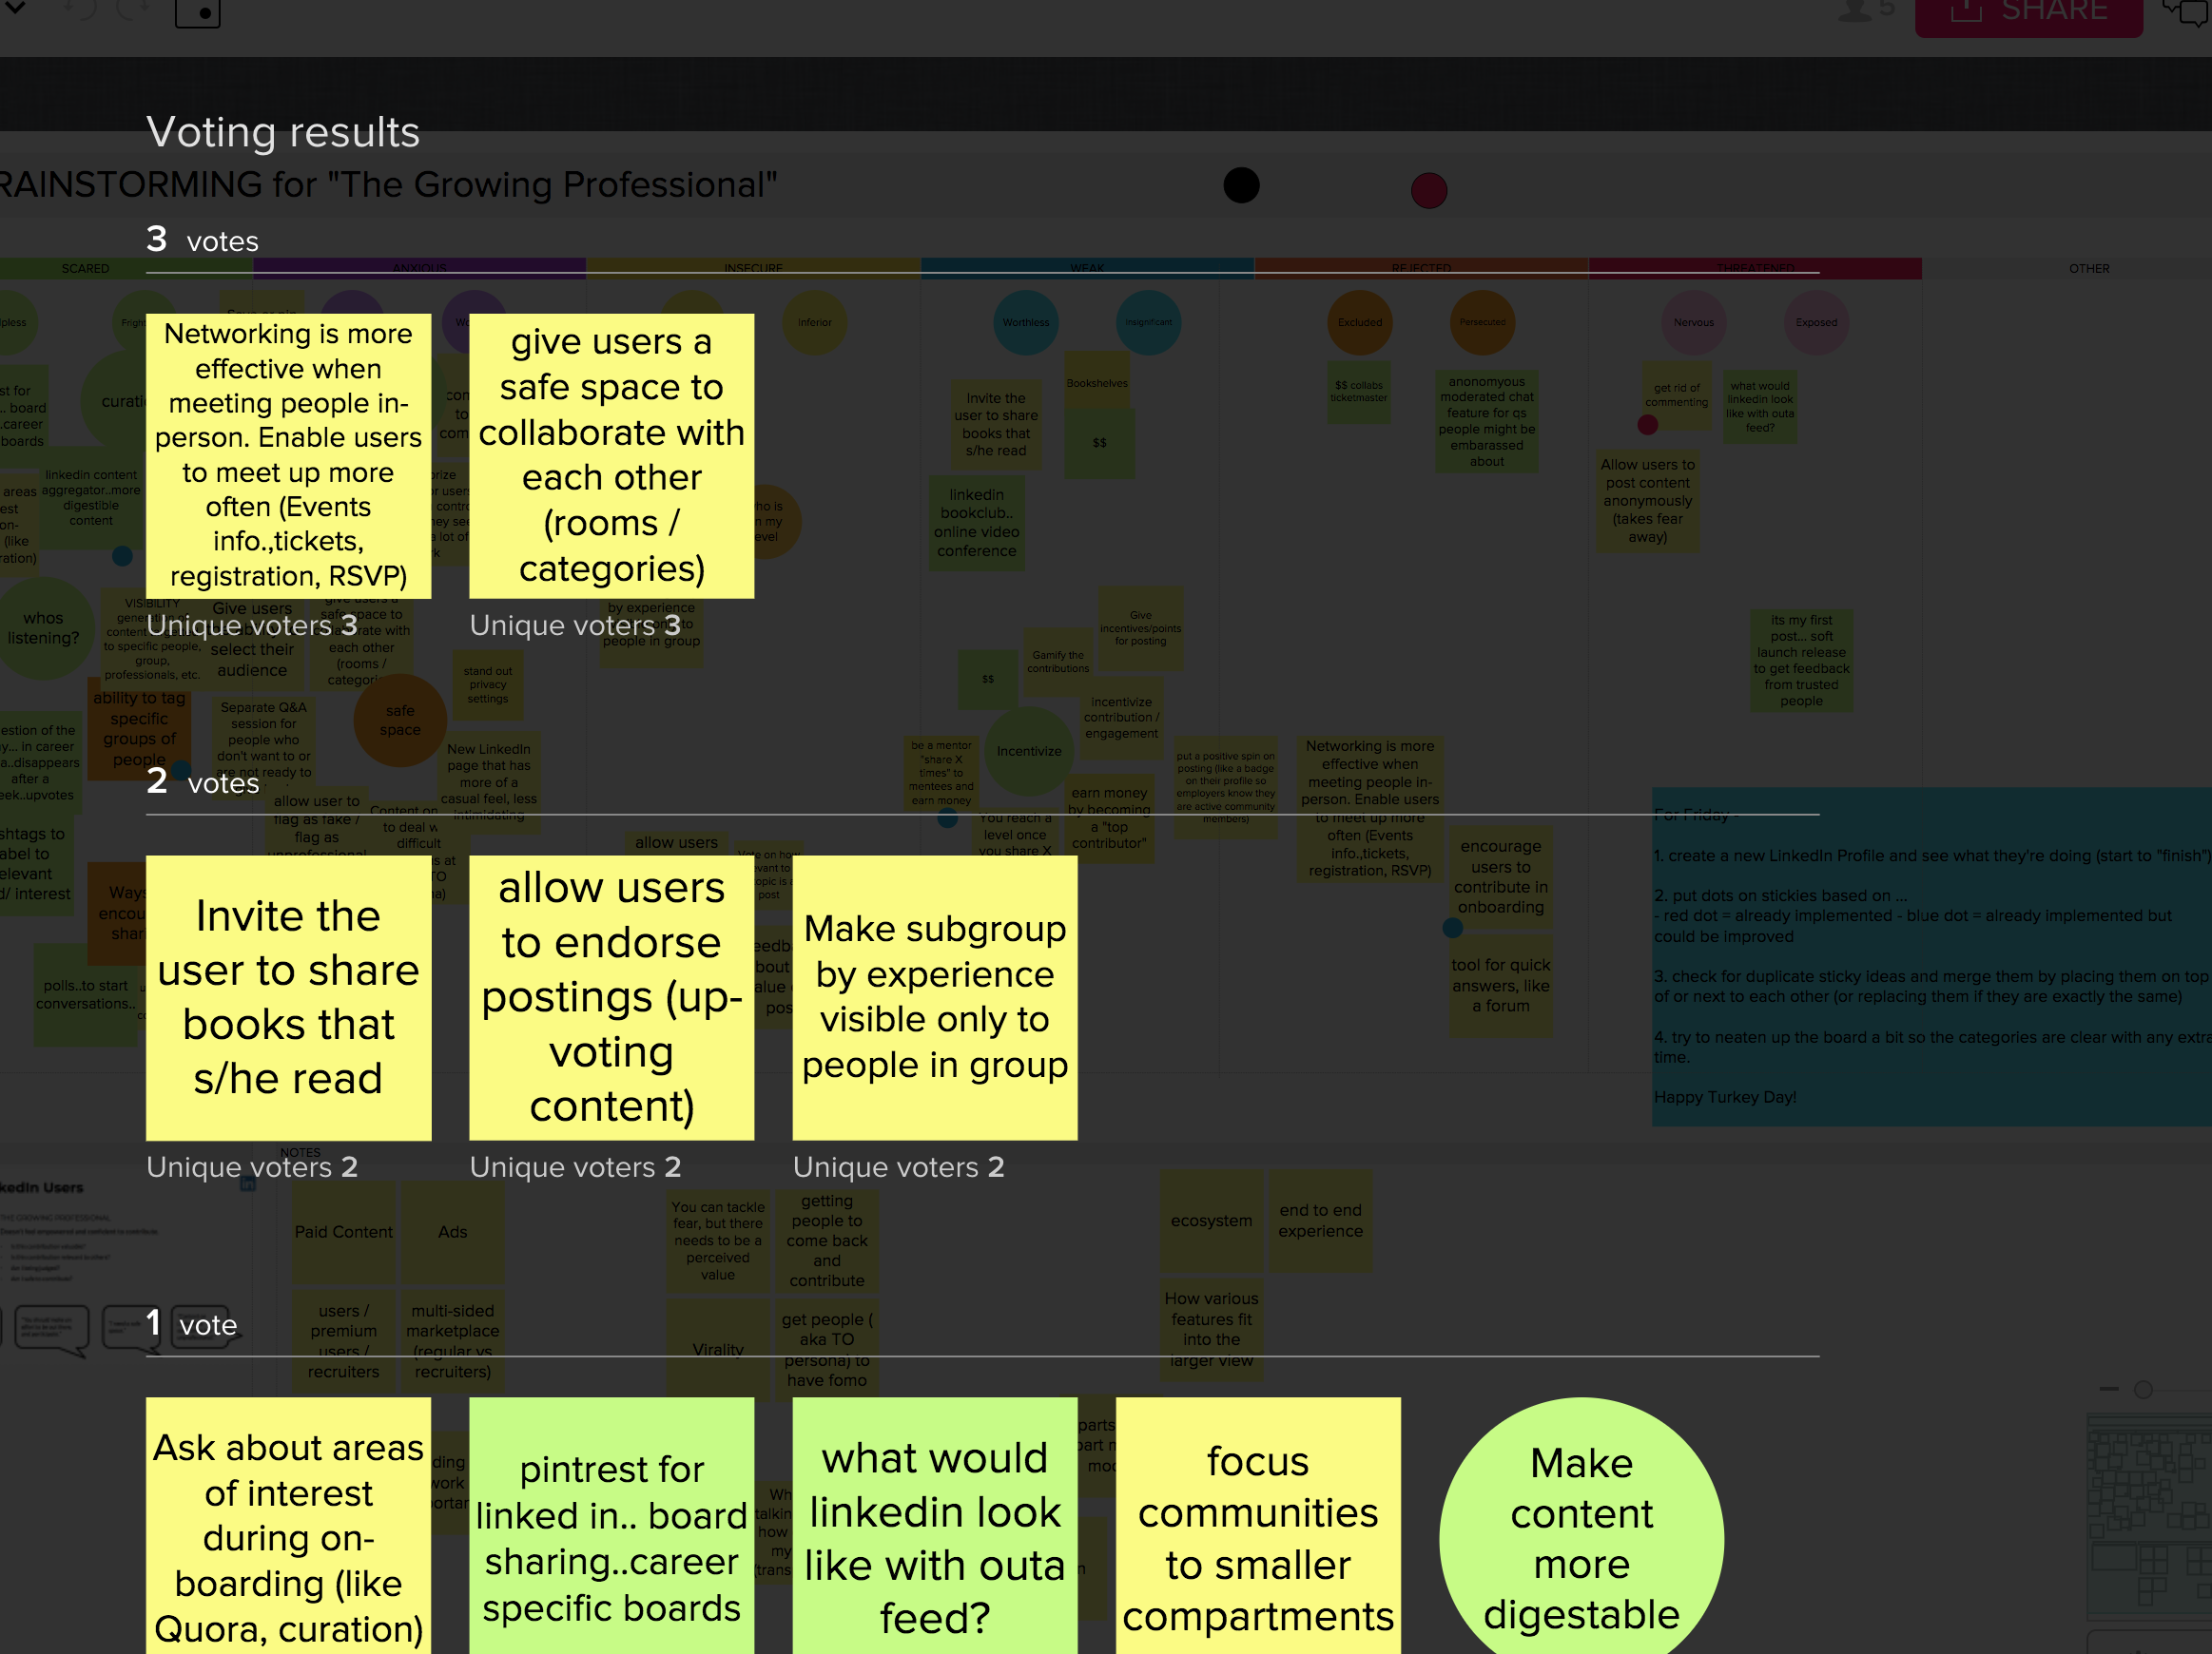
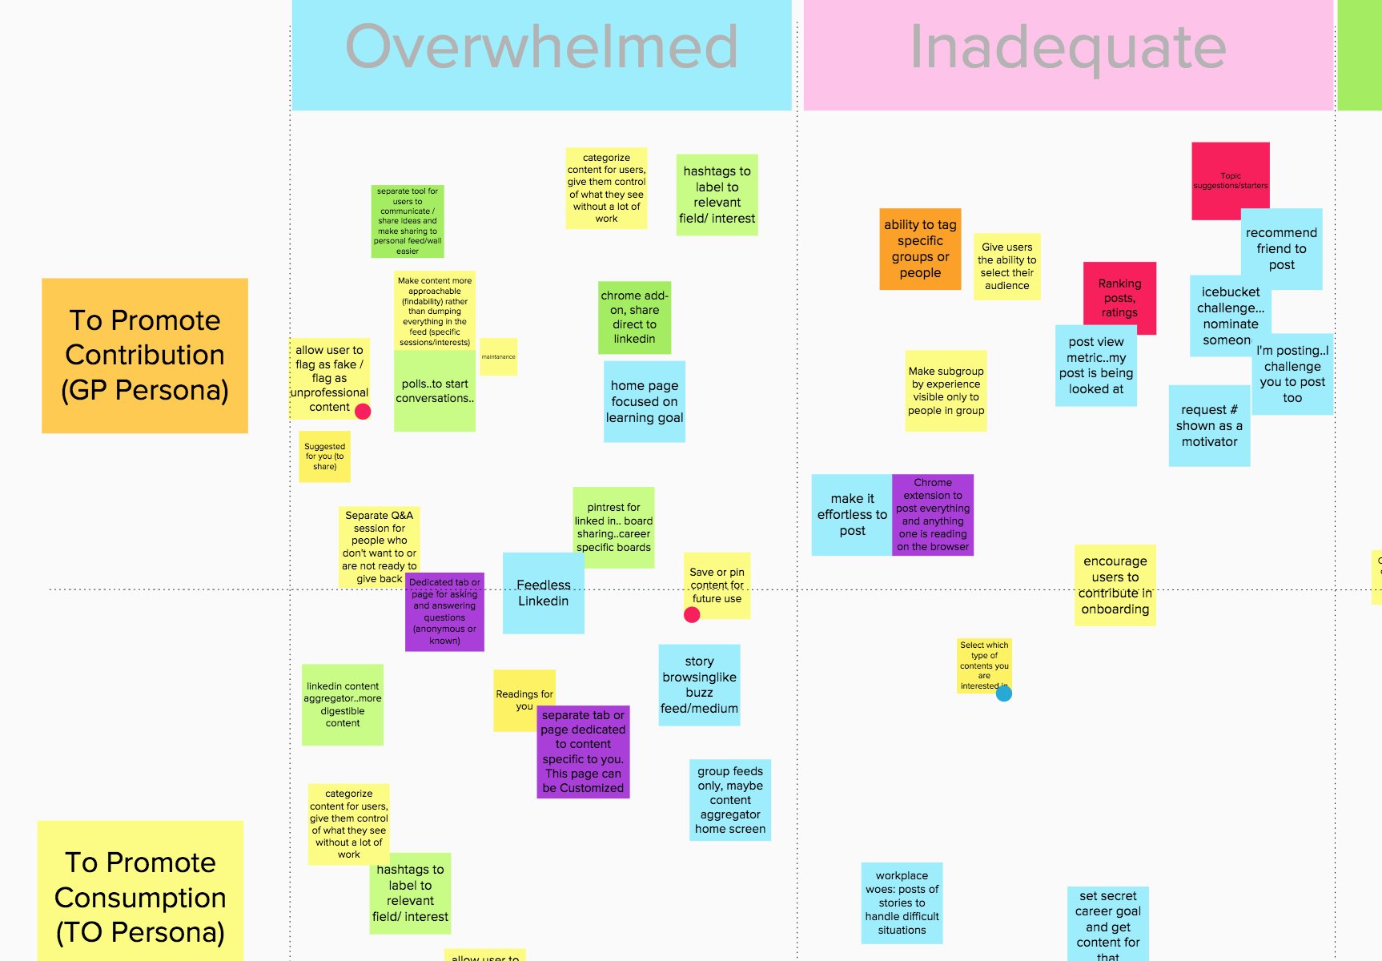
Ensur Alignment on Problems, Themes, Personas & Focus for Solutions
Aligned brainstorming with feeling Exposed, Inadequate, and Overwhelmed as well as considering users mental model of the platform / product
Voted on a number of themes and then solutions to present since every idea cannot be presented
Made Decisions based not just in user needs but also business goals / feasibility

Slide 8
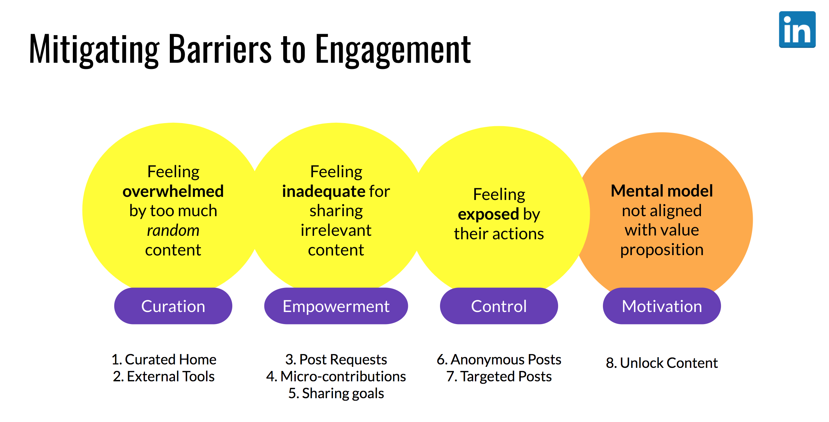
Present Solutions & Facilitate Collaborative Discussion with Stakeholder
Developed a number of unique solutions to help cultivate an engagement ecosystem where Consumption, Contribution, and Reaction feed off of themselves

Slide 9
Final REsults
Presented Ideas and Analogous Experiences to help illustrate how LinkedIn can solve their engagement problem
We kept our presentation relatively short to facilitate more time for discussion which we believe was the final step of collaboration
If we continued on this project we would continue exploratory research on the themes we’ve discovered as well as definition research to understand how users might perceive and interact with the solutions we presented

Slide 10

Thank You!
Thank you to Nancy, Deb, and Sarah for this great experience.
We wish LinkedIn good luck in improving their experience!

